Slide 1
Docker Service Deployment

Slide 2
Outline
Objectives
On completing this module, you will be able to:
Understand the concepts of containers and containerization in the context of microservices
Deploy microservices using docker technology
Topics
Service deployment
Docker
Image vs. container
Dockerfile
Basic networking for containers

Slide 3




Deploying a Microservice -- Running a Microservice on Another Machine
Book microservice
Book microservice
?
My Machine
Server Machine
The book microservice runs on my machine for development, but after the source code is transferred to the server machine, it does not run. What could be the reasons?

Slide 4
Sample Issues When Deploying a Microservice to a Different Machine
?
My Machine
Server Machine
Microservice code: book.py
Python not installed or installed with a different version
Relevant modules not installed or installed with a wrong version. E.g., Flask, Flask-SQLAlchemy, mysql-connector-python, etc.
Database problems:
Access to the WampServer/MySQL DB fails because of various network issues. E.g., wrong URI, wrong account, firewall filters
The WampServer/MySQL DB server is not installed or is not running or does not contain the needed DB table(s)

Slide 5



Mass Lunch Distribution
Imagine you are organizing a sports event in the open ground and you have to distribute lunch for 100 people. Each person needs to get some French fries, chicken nuggets and some salad.
How would you go about doing this?
Notes:
Similar problem in food distribution for an event: how to distribute the food to everyone?

Slide 6
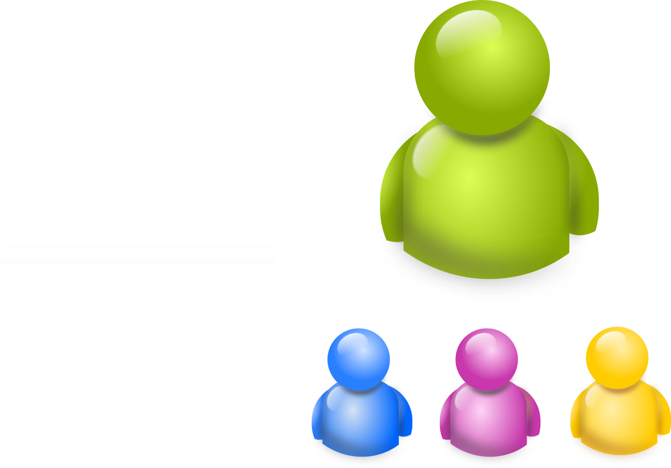


Sample Solution: Self-Served Buffet

Slide 7


Sample Solution: Packaged Lunch Boxes
Notes:
It's easier to make sure everyone gets the same amount of food, and may help to reduce queueing/distribution time.
But packaging the food often needs overheads/additional manpower to do it in advance.

Slide 8

Shipping Industry
Source: Using Docker by Adrian Mouat
Notes:
Similar problem exists in the shipping industry too.
Downside of loading & unloading of arbitrary items without standardize "boxes" that can hold most kinds of items:
- Ships spend more time at ports than in the sea, due to slow loading & unloading; which lead to lower ship utilization rate, higher shipping cost.
- Need to hire many workers to load different things at port; high wage cost; high location restrictions for the workers; small items can go missing easily.
Watch Wendover Production: https://www.youtube.com/watch?v=F-ZskaqBshs till 4:07. Containerization: The Most Influential Invention That You've Never Heard Of
Or WSJ youbute video: https://www.youtube.com/watch?v=0MUkgDIQdcM till 2:11. How a Steel Box Changed the World: A Brief History of Shipping

Slide 9


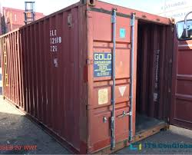

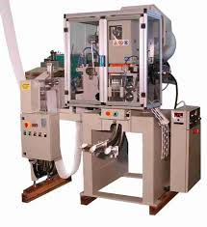
Shipping Industry
Containerization provides an easy method to load, transport and unload the goods, it provides:
Flexibility- carry a wide variety of goods
Velocity- rapid and reduced port turnaround time
Lower Cost- for loading and unloading
Notes:
Manufacturers can load items into containers at their places, with more flexible worker sources, not restricted by the port, and safer for small goods.
Faster to load and unload containers at ports.
What's amazing: the whole world cannot agree on which side of road to drive, power plug type, currency, video format, software operating systems we use…, but the container sizes are standardized.

Slide 10


Deploying a Microservice -- Running a Microservice on Another Machine
?
My Machine
Server Machine
Build
Transfer
Run
Microservice code: book.py
Python and needed modules
Right DB settings
…
Image
Container
(with automatable instructions)
an Instance of the Image
Containerization of a microservice
Package necessary items needed to run a microservice into an image that can be transferred to and run as a container on another machine
Notes:
Image here is a bundle file of the exact copy of whatever you build from the machine, nth to do with pictures
Q: does the DBMS (the database management software, WampServer/MySQL in our lab) have to be in the same image/container as the microservice code?

Slide 11
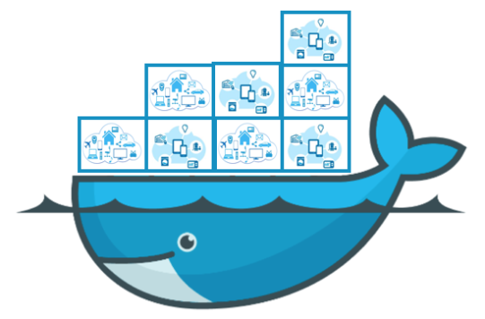


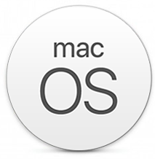
Docker
It is an open platform for developers and system administrators to package, transfer, and run microservices (or any* application) on any* machine either on premise or on the cloud
*In reality, Docker may not be compatible with some machines or applications.
Notes:
Docker itself can run on some (not all) versions of Windows, macOS, Linux.
The containers running on Docker can be Linux-based or Windows-based or macOS-based (not officially supported though).
There are alternatives to Docker (beyond the course scope), e.g.,
LXD (pronounced “lexdi”) from Canonical Ltd., the company behind Ubuntu, https://linuxcontainers.org/
rkt (pronounced ‘rocket’) from the Linux distributor, CoreOS and RedHat, https://cloud.redhat.com/learn/topics/rkt
Linux VServer, http://linux-vserver.org/Welcome_to_Linux-VServer.org
Windows Containers by Microsoft, https://learn.microsoft.com/en-us/virtualization/windowscontainers/about/

Slide 12
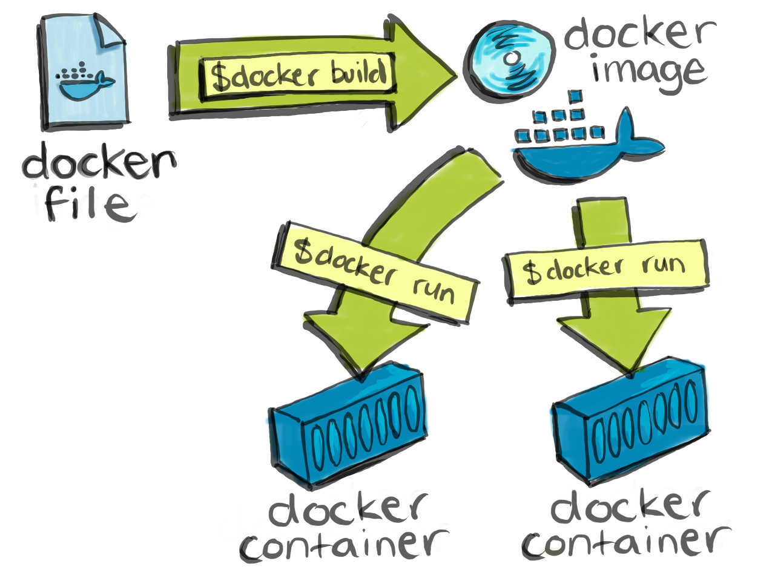
Docker Containerization Process
Microservice code: book.py
Python and needed modules
Right DB settings
…
Dockerfile contains the instructions for Docker to build an image (FROM, COPY, RUN, etc.)
Source: https://cultivatehq.com/posts/docker/
Notes:
Docker images can be pushed to or pulled from the docker hub https://hub.docker.com/
Additional notes (beyond the course scope):
Cf. https://jsta.github.io/r-docker-tutorial/04-Dockerhub.html
- Docker images on Windows can be stored as Hyper-V virtual hard disk files. They can be saved to a tar/zip file to be transferred as a usual file; and then be loaded into the docker running on another machine. cf. https://stackoverflow.com/questions/23935141/how-to-copy-docker-images-from-one-host-to-another-without-using-a-repository
- Relevant docker commands:
docker save -o <path and file name for the generated tar file> <image name> docker load -i <path to the tar file> Dockerfile reference: https://docs.docker.com/engine/reference/builder/

Slide 13







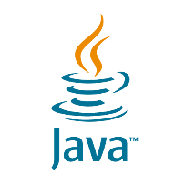


Illustration of Docker Architecture
Docker Host
(e.g., a Windows OS)
Images
Registry
(e.g., the Docker Hub)
container 1
container n
Docker Client
(e.g., a CMD window)
docker build
docker pull
docker run
docker rm
…
Docker daemon /
engine / server
Network Protocol Stack
Notes:
We install Docker on our machine, which provides the docker daemon (or called engine / server). The machine with the docker engine installed is called a docker host.
The docker client can run from another machine; in our lab, we use a cmd window on the same machine with the docker daemon installed (i.e., the docker host).
Downsides of containerization:
- Every machine that needs to run the microservice needs to have Docker installed, which introduces some performance overhead.
- Upfront investment is thus higher; images/containers take space, even if empty; many unused containers lying around may need proper management too.
- Images/containers can get damaged/lost.
It makes it easier to package inappropriate/illegal/malicious contents into images/containers without being detected.
There are alternative container runtime engines (beyond the course scope); they can load and run images built by Docker. e.g.,
- containerd: https://containerd.io/
CRI-O: https://cri-o.io/
My own notes:
Qn: What is a docker host?
Ans: Our own systems running the docker software

Slide 14

Communication on a Docker Host
Images
container 1
container 2
CMD
docker build
docker pull
docker run
docker rm
…
Docker Client
App 1
App 2
Libs 1
Libs 2
App X
Docker Engine
Libs X
Docker Host
(e.g., a Windows OS)

Slide 15
IP Address
Machine A
Machine B
subnetwork
(private / internal / local network)
192.168.128.75 192.168.0.101
(Host IPs in home network)
Gateway
Internet/Network
Gateway
subnetwork
(private / internal / local network)
10.4.4.38 10.10.16.18
(Host IPs in SMU network)
Machine C
Machine D
Notes:
Each machine may belong to multiple (sub)networks at the same time. It can have multiple IP addresses at the same time too. And, different machines in different (sub)networks can have the same IP address at the same time.
Broadly speaking, two machines can communicate with each other as long as they have a way to identify each other in a network. But in reality, there are many other factors in play that may affect the communication, e.g., firewalls installed on the machines and in the network may block the communication; the machines may belong to different (sub)networks and they don't recognize each other's IP; etc.

Slide 16
Container Networking
…
Internet/Network
Gateway
SMU subnetwork
10.4.4.38 10.10.16.18
host.docker.internal
subnetwork X
subnetwork Y
Machine C
172.17.0.1
172.17.0.1
Machine D
Docker engine acts as a gateway for the containers
Docker engine acts as a gateway for the containers
Container 1
Container 2
Container 3
172.17.0.3
172.17.0.2
172.17.0.2
Notes:
Each container running on a docker host is in an internal subnetwork set up by the docker engine. Docker engine acts as a gateway for the containers, providing networking capabilities.
A docker engine sets up an internal network on the docker host, and assigns dynamic IP address(es) to each container in the internal network, often in the range of 172.x.x.x. The IP addresses are only valid for the internal network.
There are different ways to enable communications among containers.
Our course covers the basic default ways to enable communication among containers:
- Containers and the host in the same internal network by default can communicate with each other by using their IP addresses in the same internal network.
- Each container can be assigned a name too; a container can communicate with other containers in the same subnetwork via the container names (act like hostnames for physical machines).
- The latest version of Docker defines a special hostname host.docker.internal on Windows or macOS for the docker host; so, a program running within a container can use the special hostname to communicate with its host.
- Each container communicating with external network(s) needs network address translation (NAT) through the docker engine and docker host, e.g., port mapping (a particular kind of NAT).
Additional notes (beyond the course scope):
docker inspect <container id> will show a lot of information about the container, including its IPAddress.
Whether containers and hosts across different internal networks can communicate with each other depends on many networking settings between the different hosts.
Further in-depth technical details (beyond the course scope): https://docs.docker.com/network/
My own notes:
Qn: is there any drawback for containerisation
ANS: take more time to process docker compared to a single software/application, and also Running many containers on a single host may lead to resource contention, impacting performance.

Slide 17

Accessing a Microservice Inside a Container
An external client may directly access the host IPs in the external network but not the container IPs (because internal IPs are invalid externally)
A common solution is to have an intermediary to translate between external and internal IPs
Docker Host
Internal network
Internet/ Network
container
Client / Service Consumer
?
Microservice
Libs
Docker Engine
Notes:
The docker engine can be such an intermediary for network address translation.

Slide 18
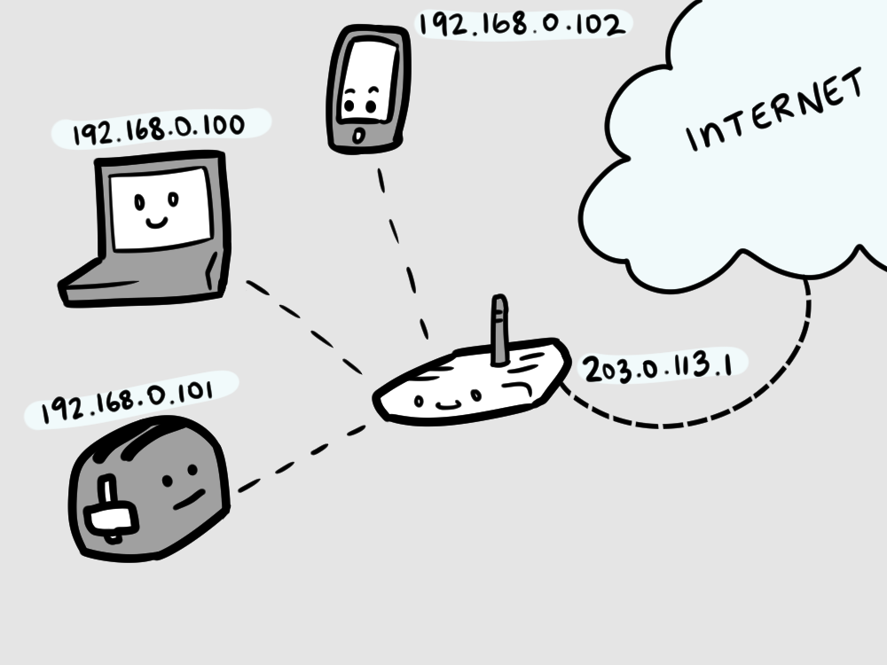
Network Address Translation (NAT)
Map one network address (e.g., an IP and a port number) to another by modifying the address information in network communication data
So that, data can be (re)routed by the network to a different receiver or can appear to come from a different sender.
E.g., the router at our home
192.168.0.1
Notes:
An IP in one network may not be accessible from Internet or another network. Network Address Translation (NAT) is one of the ways to enable communication across networks, through a device that has IPs in both networks.

Slide 19
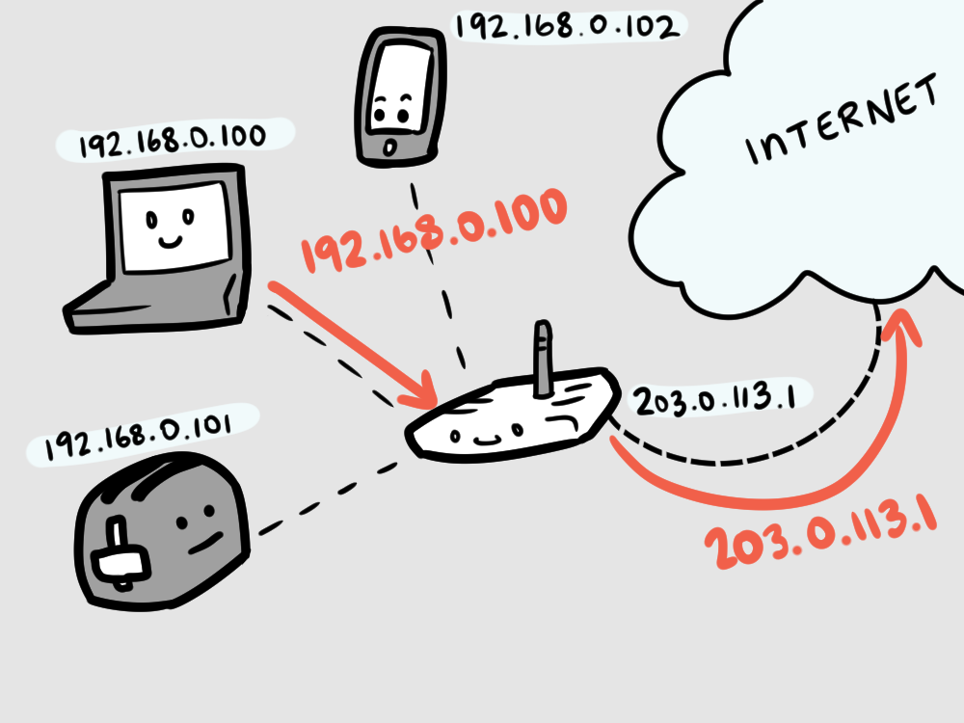
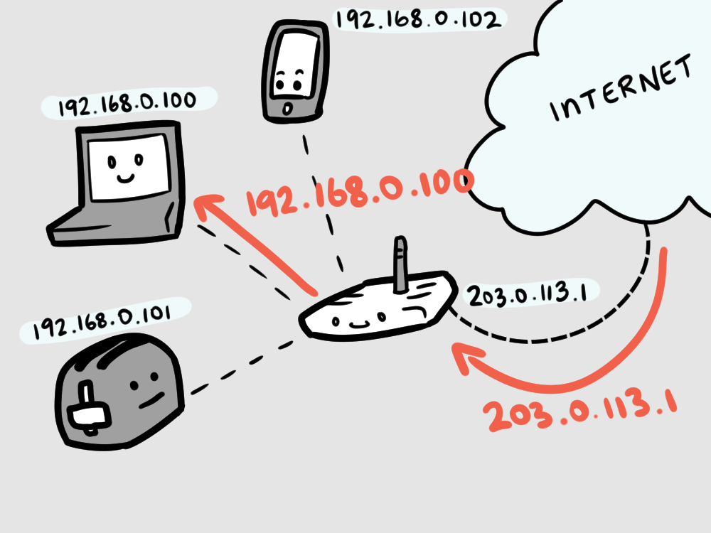
Network Address Translation (NAT) Enabled Router
Request
Reply
142.251.10.139
142.251.10.139
192.168.0.1
192.168.0.1
Courtesy of Cube Drone’s buildatheweb. Licensed under a Creative Commons Attribution-NonCommercial-ShareAlike 4.0 International License.
Notes:
The example here is for internal machines to request for external services via a NAT-enabled router, which dynamically maps IPs for each request from internal machines.
If to send a request from Internet to an internal machine, an IP/port mapping needs to be setup in the router before the request happens.
We’ll learn how to do this later for Docker containers/virtual networks.
Some guy in the middle in this case router do certain recording to recognise internal and external processing

Slide 20
Accessing a Microservice Inside a Container via Port Mapping (a.k.a. Port Forwarding)
Port mapping is a kind of NAT, redirecting communication data from an IP:port number to another IP:port number
Internal network
Running at port 5000 in the container
container
Microservice
Libs
Request
http://10.4.4.38:5100
(External) Client
172.17.0.3
http://172.17.0.3:5000
Response
Docker Engine
mapping 5000 to 172.17.0.2:5000
mapping 5100 to 172.17.0.3:5000
……
Internal IP: 172.17.0.1
Docker Host
External IP: 10.4.4.38
Notes:
Each container gets its internal IP address(es) when it is started by the docker engine. Each container, like a virtual machine, also has its (internal) port numbers, the same as a normal machine.
The docker engine maps an (external) port of the docker host (a.k.a. host port) to an (internal) port of the container (a.k.a. container port); after that, all incoming request data going to the host port is forwarded to the container port of a particular container; the data replied from the container is forwarded by the docker engine and host back to the original client.
References (beyond the course scope):
https://en.wikipedia.org/wiki/Network_address_translation
https://en.wikipedia.org/wiki/Port_forwarding

Slide 21
Bookstore Lab Scenario

Slide 22
Running the Book Microservice in Multiple Containers
docker run -p 5000:5000 -e <url_to_db@host.docker.internal:3306/book> <image name>
docker run -p 5100:5000 -e <url_to_db@host.docker.internal:3306/book> <image name>
……
http://localhost:5000
container 1
container 2
Images
book.py
http://localhost:5100
Book
Book
CMD
docker build
docker pull
docker run
docker rm
…
Docker Client
libs
Book DB
Libs
Libs
Client (e.g., a Web browser)
MySQL
Docker Engine
mapping localhost:5000 to 172.17.0.2:5000
mapping localhost:5100 to 172.17.0.3:5000
……
WampServer
Docker Host
(e.g., a Windows OS)
Notes:
Q: does the DBMS (the database management software, WampServer/MySQL in our lab) have to be in the same image/container as the microservice code?
- No.
Questions to consider:
- For clients, will there be too many URLs to remember, in order to invoke various instances of the microservices? Load balancer and API gateway can be used to alleviate the problem (we will learn API gateway in a few weeks time).
- Will there be too many containers to manage? We can use a container management tool, such as docker compose (we will learn in a few weeks time); (the following is beyond the course scope) and/or NGINX, Kubernetes (k8s, https://kubernetes.io/) cf. https://pspdfkit.com/blog/2018/how-to-use-docker-compose-to-run-multiple-instances-of-a-service-in-development/

